Slide 1

Data Science Journey: Building Intelligent Solutions
Naitik Goyal | Data Science Domain
USC_TIA Program | Industrial Internship Project Overview roll no . 25scs1003003123

Slide 2
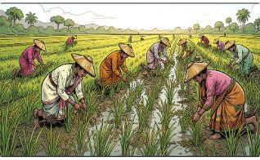
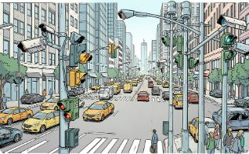
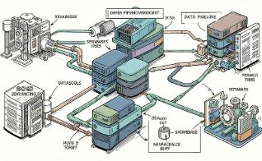
Internship & Project Arc
Agriculture — Crop Production Prediction
Smart City — Traffic Forecasting
Goal
Translate raw heterogeneous data into actionable, sustainable solutions for farmers and city planners.
Real-time AI-driven urban mobility: reduce congestion, prioritize emergency routing, and optimize emissions-aware routing.
2001–2014 Indian agricultural datasets; objective: reliable yield forecasts to support farmer decision-making.

Slide 3


Agriculture: The Food Security Challenge
Problem: Traditional farming in India faces increasing volatility from climate variability, changing rainfall patterns, and soil degradation. Stakeholders—smallholder farmers—need predictive insights that are accessible, reliable, and actionable to protect yields and livelihoods.
Design emphasis: models must be robust to sparse records and deliver interpretable recommendations for field-level decisions.

Slide 4
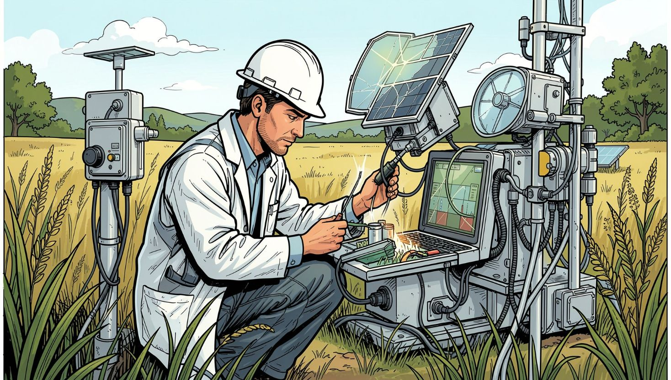
Agricultural Data & Preprocessing
Sources: GKVK and DES databases — multi-year records of temperature, rainfall, soil pH, soil moisture, and administrative labels (State, Season, Crop).
Challenges
Preprocessing Steps
Data Ops
Missing months, inconsistent sampling rates, and mixed categorical encodings.
Impute missing values with seasonal medians and KNN where appropriate
Detect & remove measurement outliers (rolling z-score)
Encode State/Season/Crop using ordinal + target encoding
Pipelineed in Pandas → parquet; versioned snapshots for reproducibility.

Slide 5

Agri — EDA & ML Plan
EDA revealed key drivers: cumulative sunlight, soil pH bands, and sustained humidity windows correlate strongly with yield variance. Spatial heterogeneity across states requires localized models or state-aware features.
01
02
Baseline
Advanced Models
Linear and ridge regression (scikit-learn) to set performance floor and analyze residuals.
Random Forest and Gradient Boosting to capture non-linear feature interactions and heteroskedasticity.
03
Evaluation
Time-aware CV, MAE & RMSE reporting, SHAP for model interpretability at crop-state level.

Slide 6
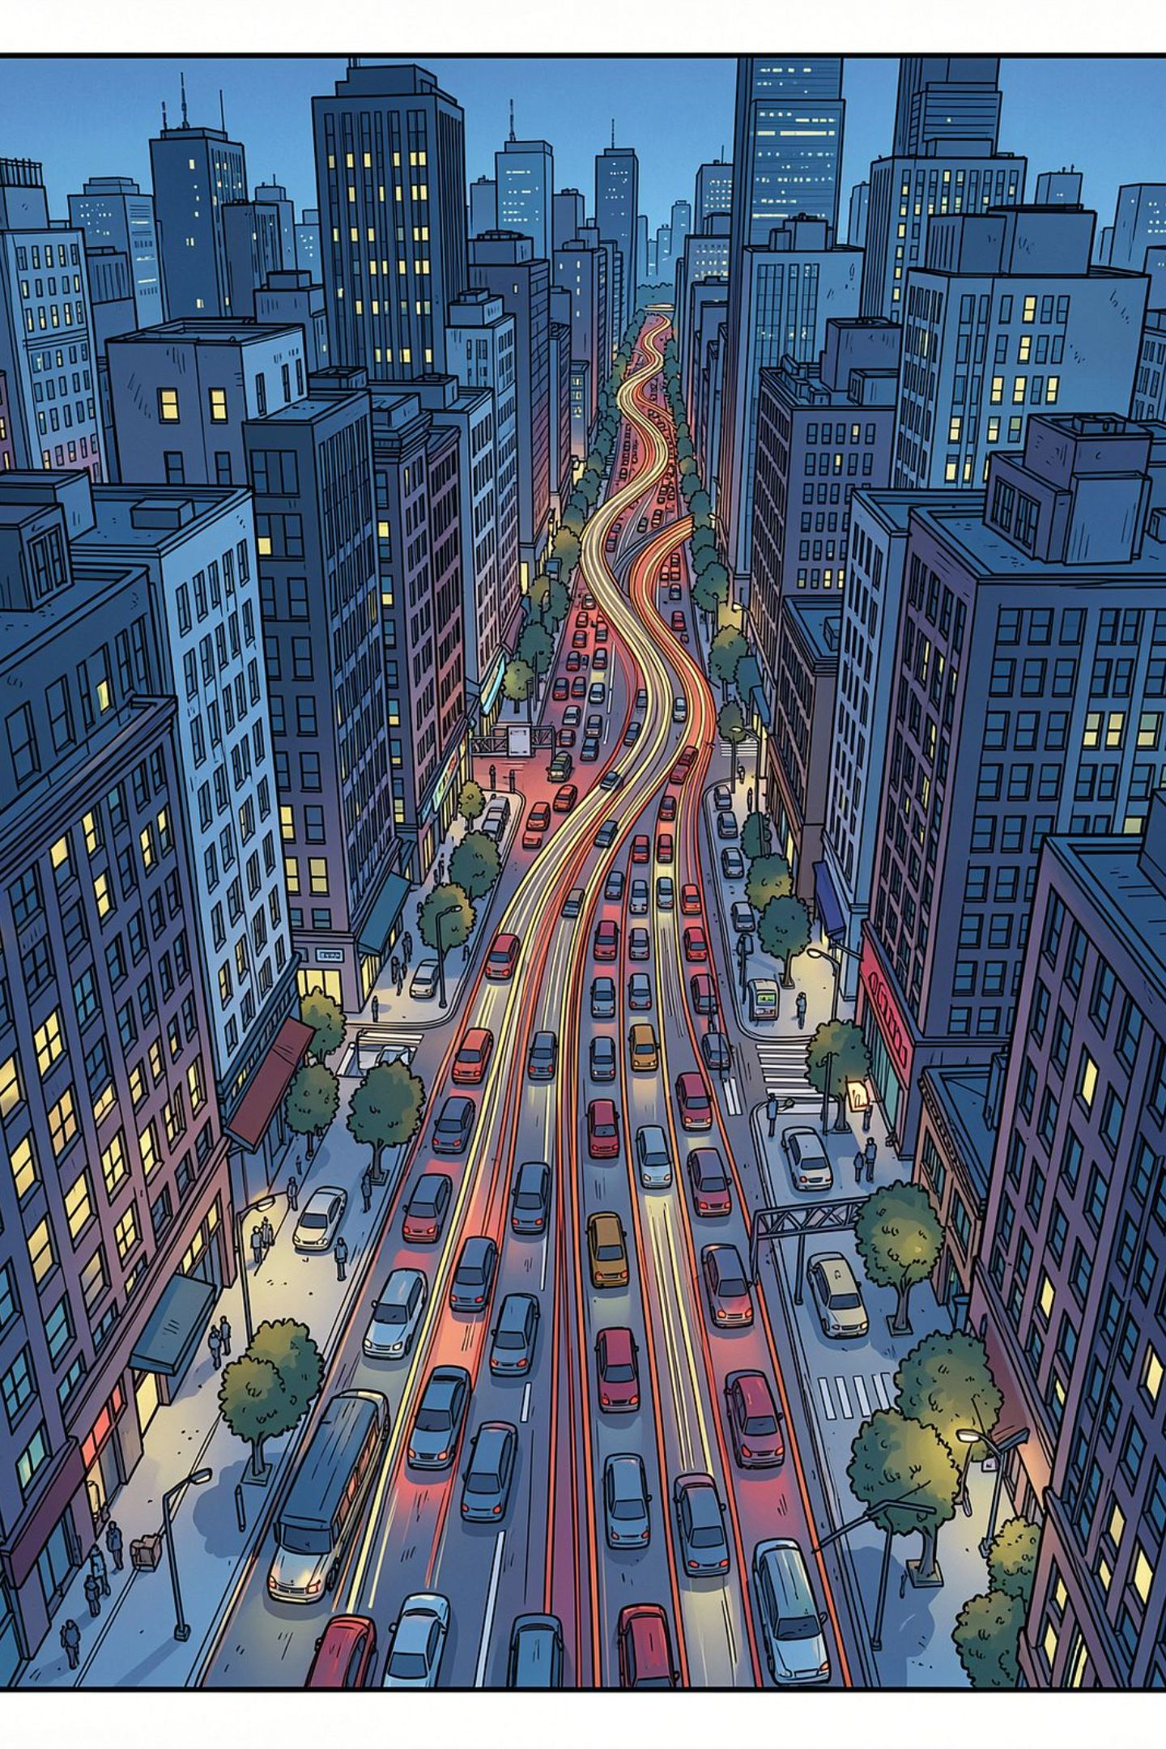
Smart City: The Congestion Crisis
Problem: Rapid urbanization causes gridlock, higher emissions, and delayed emergency services. Solution: RushSlayer — an integrated AI traffic management platform that forecasts flow and enables dynamic control (lane allocation, signal timing, prioritized corridors).
Priority: low-latency forecasts and privacy-preserving sensor integration for municipal deployment.

Slide 7
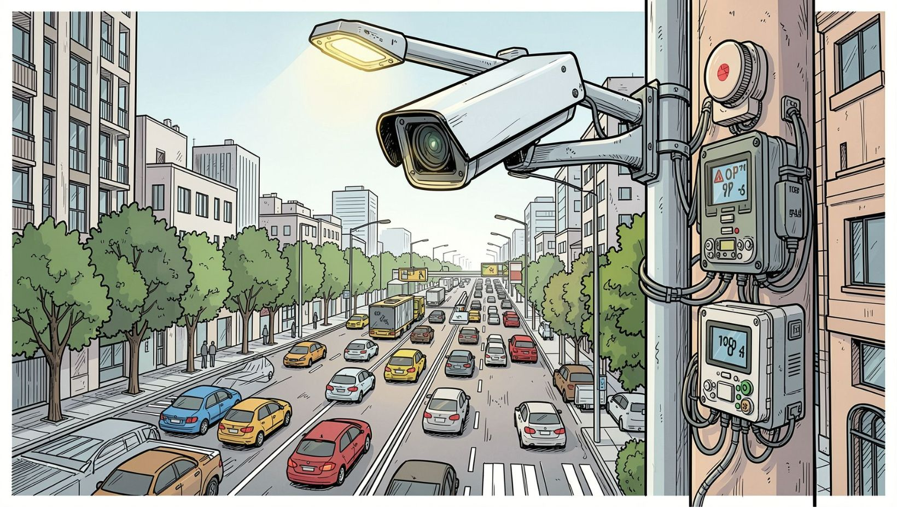
Traffic Dataset & Cleaning
Inputs: CCTV video-derived counts, loop and radar sensors, GPS probe data, and citizen feedback. Data are spatiotemporal: camera ID / lat-lon, timestamps, vehicle counts, speed distributions, and incident notes.
Structuring
Cleaning
Storage
Aggregate to fixed intervals (5-min), align timezones, and geohash road segments.
Interpolate short gaps, drop faulty sensors, normalize counts by lane capacity; deduplicate citizen reports.
MongoDB for events, Redis for low-latency rolling windows, S3 for archived video frames.

Slide 8
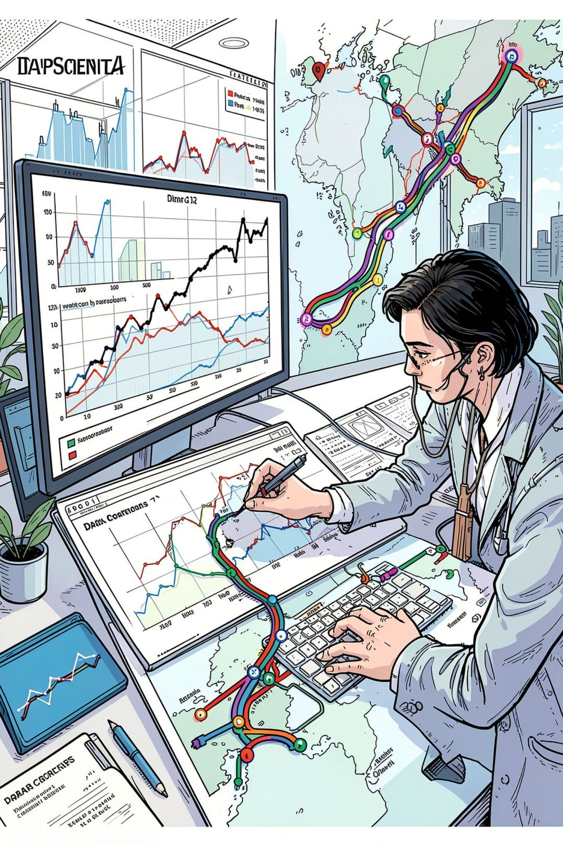
Smart City — EDA, Features & Modeling
EDA identified consistent commute peaks (7–9 AM; 4–6 PM) and special-event spikes. Spatial dependence across adjacent road segments is non-Euclidean—graphs better represent connectivity than plain grids.
Temporal Features
Lag counts, rolling windows, day-of-week, holiday flags, weather overlays.
Spatial Features
Graph adjacency, road capacity, intersection delay, nearby incidents.
Modeling Approach
CNN for local spatial patterns + LSTM for temporal dynamics; explore Graph Neural Networks (GNN) to model road topology.

Slide 9

Forecasting, Peaks & Operational Impact
Forecast horizon: 12 steps ahead (e.g., 1-hour with 5‑min intervals). Outputs feed dynamic lane allocation and pollution-aware rerouting. Peak detection triggers preemptive measures for emergency corridors.
Data Ingestion
Short-term Forecast
Dynamic Control
Peak Mitigation
Expected Impact
Reliability
Reduce commute times by ~20–30% in targeted corridors; lower idling emissions; faster emergency response.
Ensemble forecasts with uncertainty intervals and fallback rules for sensor outages.

Slide 10
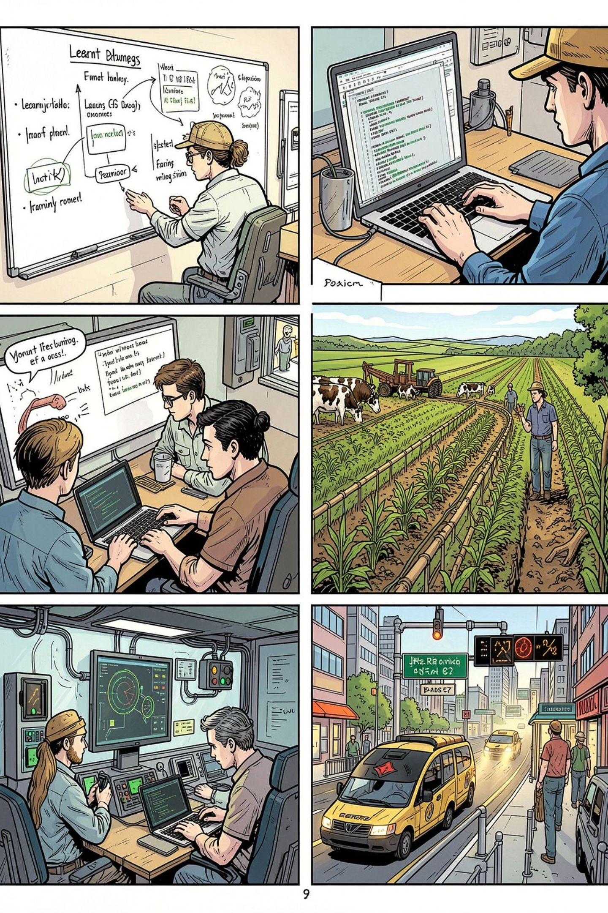
Learning Journey — Weeks 1–2 & Project Synthesis
Weeks 1–2: Rapid onboarding—data inventory, environment setup (Docker, conda), basic EDA, and baseline models established. Project phase: iterative model development, domain-informed feature engineering, and deployment-ready pipelines for both agriculture and traffic domains.
Skill growth: time-series methods, spatial modeling, MQTT & low-latency infra
Project output: reproducible pipelines, model interpretability, and deployment proofs-of-concept

